Slide 1

Exploratory Data Analysis - Key Findings

Slide 2
Overview of MetroMove Transit Solutions
A public transportation service provider operating across multiple cities - managing thousands of daily trips to deliver efficient, affordable, and timely transit for every passenger.
Multi-City Operations
Multiple Transport Modes
Data-Driven Mission
Providing seamless transit services across multiple metropolitan areas, connecting communities and enabling urban mobility at scale.
Managing an integrated network of buses, trains, ferries, and trams — giving riders flexible options for every journey.
Leveraging analytics and operational data to continuously improve passenger experience, optimize routes, and enhance service reliability.
Scalable
Connected
Bus
Train
Ferry
Tram
Analytics
Optimization
Mission: Provide efficient, affordable, and timely public transportation — using data to elevate every ride and
every route across every city we serve.

Slide 3


Slide 4
METROMOVE TRANSIT SOLUTIONS
Data Cleaning Summary
Four-step pipeline preparing raw trip data for analysis
1
2
3
4
Removed Noise
Imputed Missing Values
Standardized Categories
Feature Engineering
Dropped 2 columns (Unnamed: 10 & 11) with extremely high null values and no meaningful information.
Passenger_Count imputed with 0 (real-world valid). Fare_Amount & Trip_Duration imputed with mean due to minimal mean-median difference.
Regenerated Day_of_Week from Trip_Date to fix inconsistencies. Added Trip Month, Trip Day, Departure Time, and Hour as new derived features.
Trimmed whitespace and applied consistent casing to all categorical columns for uniform text representation across the dataset.
RAW DATA → ANALYSIS-READY DATASET

Slide 5
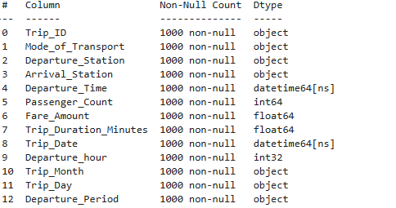
Data Info Following Data Cleaning

Slide 6
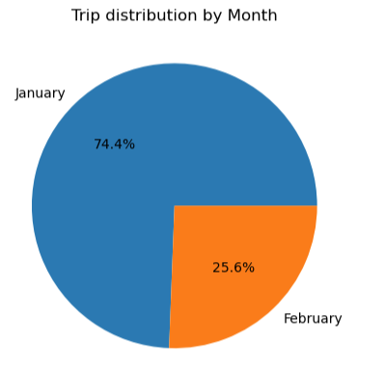
Months Captured on Data Set

Slide 7
Insights Generated
Univariate and Bivariate Analysis Outputs

Slide 8
Univariate Findings: Categorical Variables
Distribution patterns across transport modes, stations & temporal dimensions
Mode of Transport
Departure Station
Bus is the most frequently used mode, followed by Ferry and Train. Tram is the least used. Road-based transport dominates the network.
Central has the highest departures, serving as a major hub in the network. South Point has the fewest departures.
DOMINANT: BUS
HUB: CENTRAL
Arrival Station
Temporal Patterns
Airport receives the most arrivals despite not being the top departure point — indicating it is a key destination. North Station has the lowest arrivals.
January accounts for significantly more trips than February. Daily trip counts are stable Mon–Sat, with only a small dip on Sundays.
DESTINATION: AIRPORT
PEAK: JANUARY

Slide 9
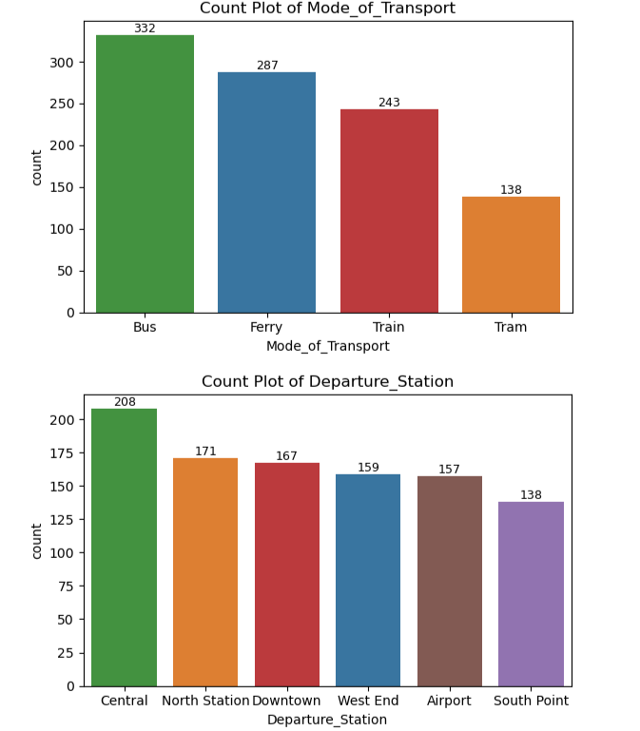
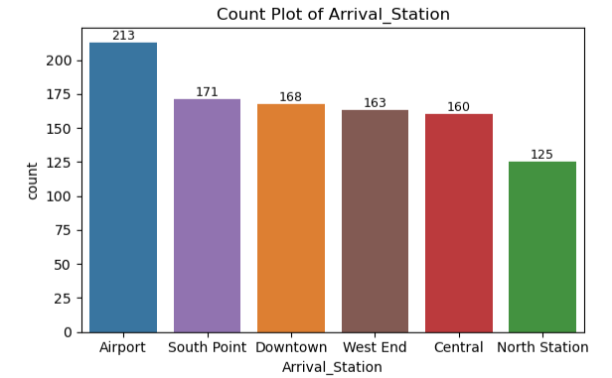
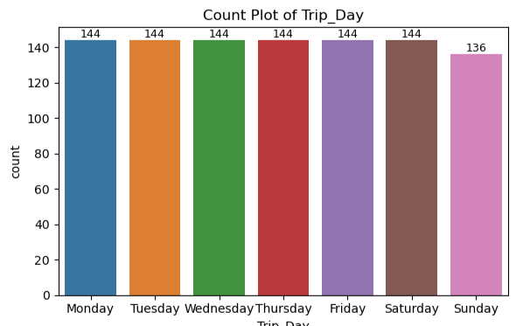

Slide 10
Univariate Findings: Numerical Variables
Distribution characteristics across key numeric features
PASSENGER COUNT
FARE AMOUNT
Low Occupancy
25–30 units
Dominated by low values — solo or low-occupancy trips are the norm.
Most common fare range is 25–30 units; some higher fares occur infrequently.
TRIP DURATION
DEPARTURE HOUR
~100 min
Scheduled Pattern
Centered around 100 minutes with a clear central mass — fairly consistent durations.
Departures follow a timetable-like structure, suggesting periodic/scheduled services.
METROMOVE TRANSIT SOLUTIONS

Slide 11
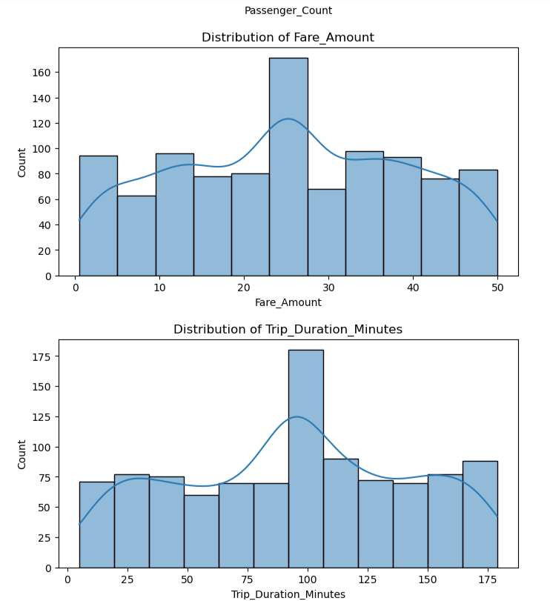
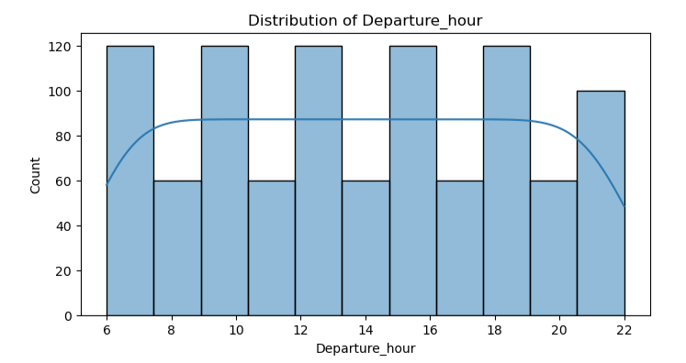

Slide 12
— Bivariate Analysis Findings —
Fare by Transport Mode
Trip Duration by Transport Mode
Average fares across Ferry, Tram, Bus, and Train are almost identical — indicating a standardized fare structure across the network.
Average trip durations are very similar across all modes (92–96 minutes); no mode is significantly faster or slower.
Transport Mode by Period of Day
Passenger Count by Day of Week
Ferry peaks in the morning, Bus dominates afternoon & evening, all modes drop at night, and Tram is lowest throughout.
Volume is stable across the week; Friday has the highest count, Sunday the lowest — consistent demand with minor fluctuations.
METROMOVE TRANSIT SOLUTIONS
Exploratory Data Analysis

Slide 13
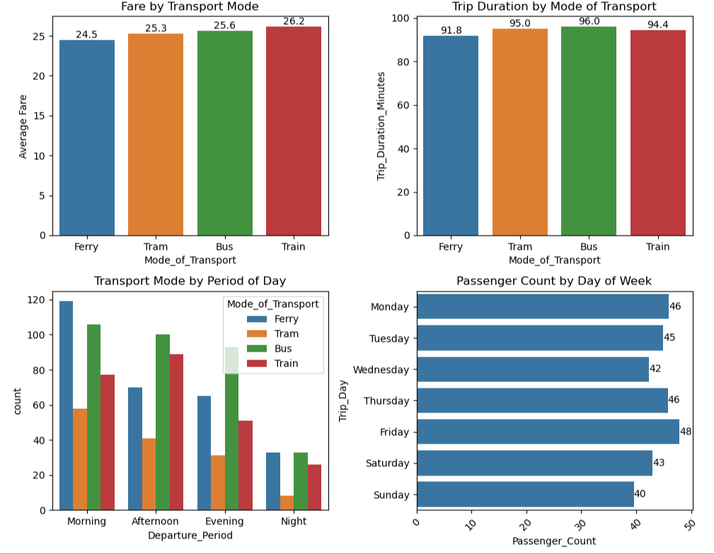

Slide 14
— Network Demand & Fare Structure —
Station-to-Station Demand
Fixed Fare System
Heatmap of route concentration
Flat-rate pricing confirmed
Central
Airport
North
East
S. Point
—
High
Med
Med
Low
Fare vs. Trip Duration
r ≈ 0.00
Central
High
—
Low
Med
Low
No relationship — fare stays constant regardless of trip length
Airport
Med
Med
—
Low
Low
Fare vs. Passenger Load
r ≈ 0.00
North
Med
Med
Low
—
Low
No relationship — fare is unaffected by number of passengers
East
Low
Low
Low
Low
—
Fare vs. Transport Mode
S. Point
r ≈ 0.00
Low
High
Uniform fares across Bus, Ferry, Train, and Tram
The busiest routes concentrate around Central and Airport as dominant network nodes, with the Central ↔ Airport corridor showing the highest passenger demand.
Confirmed: Flat-rate pricing model — fares are independent of duration, occupancy, and mode.
METROMOVE TRANSIT SOLUTIONS
Exploratory Data Analysis

Slide 15
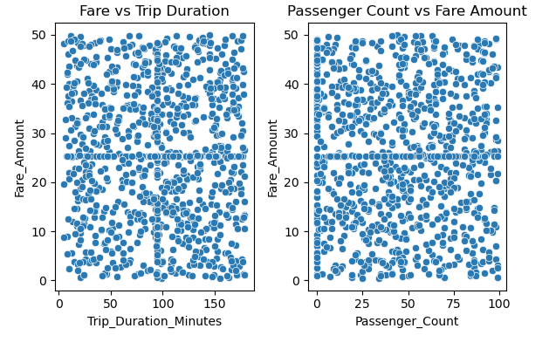

Slide 16


EDA SUMMARY
EDA Summary: The Big Picture
Bus dominates as the primary transport mode, with Central as the main departure hub and Airport as the top arrival destination.
Fares, trip durations, and weekly demand are highly uniform across transport modes and days — a balanced, predictable network.
The fare system is flat-rate, with no dependency on trip duration or passenger load.
January has significantly more trips than February — seasonal or data collection effects should be investigated.
Low passenger occupancy per trip suggests potential for capacity optimization or demand stimulation strategies.
METROMOVE TRANSIT SOLUTIONS
EXPLORATORY DATA ANALYSIS

Slide 17

RECOMMENDATIONS & NEXT STEPS
-- Next Steps --
From Data to Decision
1
Investigate January–February trip imbalance to distinguish seasonal demand from data gaps.
2
Explore route-level optimization for high-demand station pairs (Central ↔ Airport corridor).
3
Evaluate fare structure flexibility — consider dynamic pricing or occupancy-based incentives to boost ridership.
Leveraging these EDA insights to drive operational improvements at MetroMove Transit Solutions.
EDA Report

